Slide 1
Python stuff
How to set up anaconda, pycharm etc in Dim GK and Produktsimulering

Slide 2

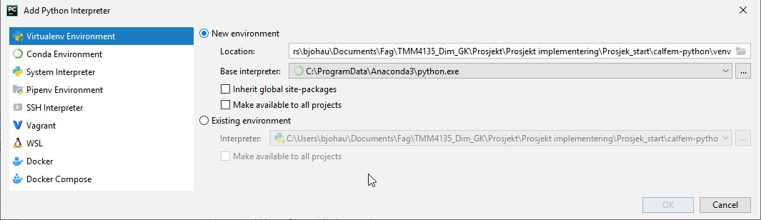
Pycharm
Define a new interpreter

Slide 3
Create virtual environment
python -m venv venv
.\venv\Scripts\activate
pip install numpy
pip install meshio

Slide 4
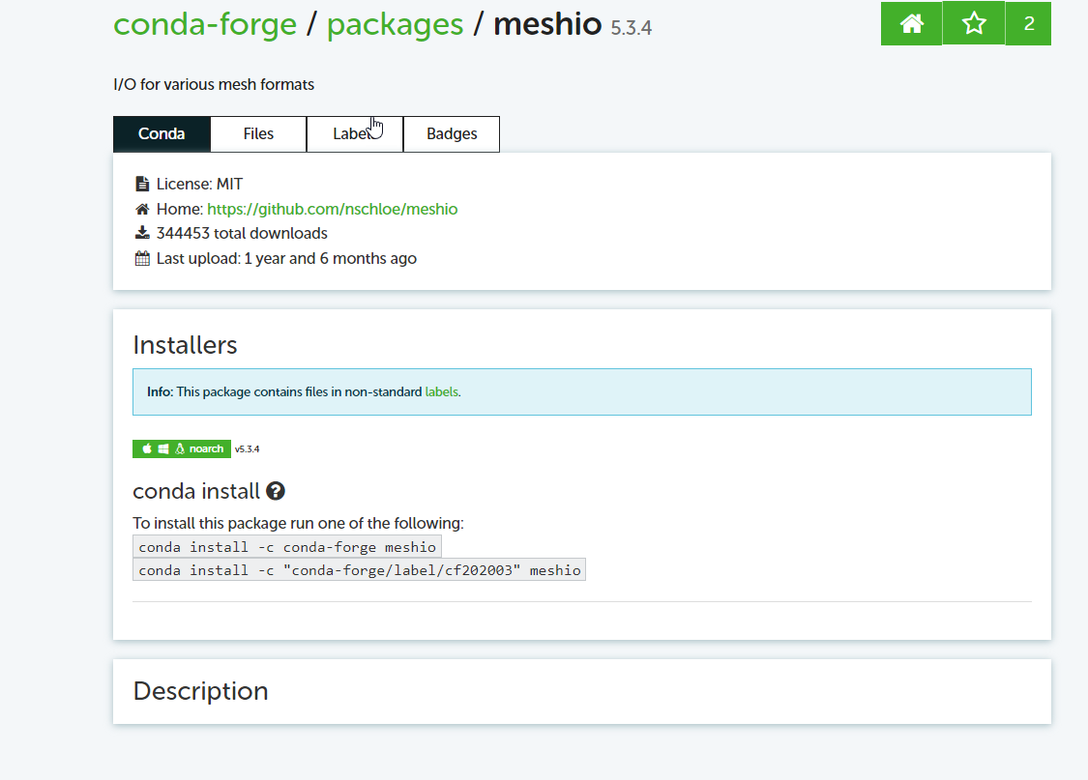
Meshio for conda environment

